Slide 1
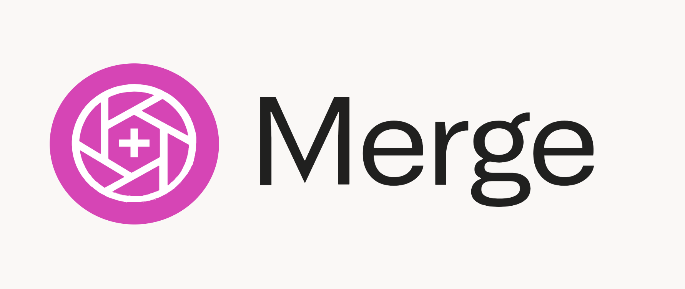
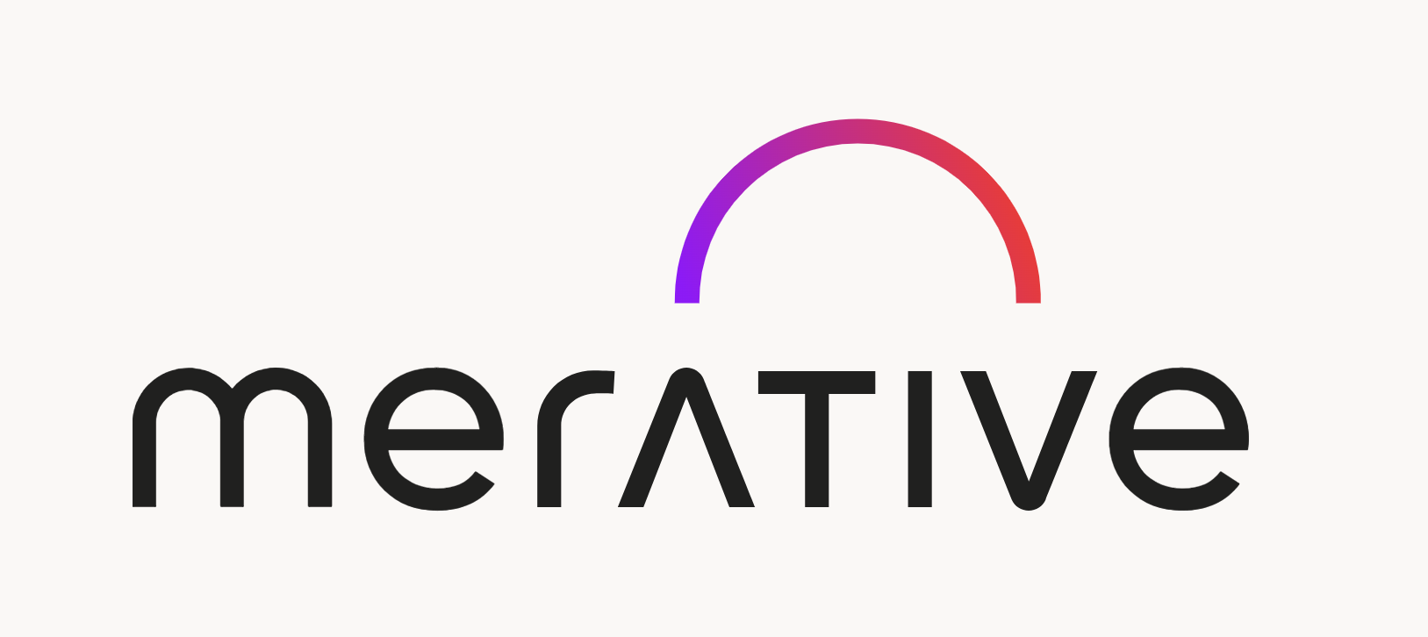
Merge by Merative
Dikshaa Vikram

Slide 2

Sections
01
02
03
04
05
06
Key Features
Leveraging AI
Major Value Propositions
Amazing key findings of Merge by Merative
How does Merge leverage AI in radiology space
Values that Merge contribute to radiology space
Marketing Statergy
SWOT
Competitive Framework
How does Merge place itself inbetween its competitors
SWOT analysis on Merge to make informed decisions
Business model canvas to understand the depth of merge

Slide 3
— Merge by Merative’s Mission
“Based on the core imaging portfolio, we help clients expand into enterprise imaging, then transform to embrace cloud services for more scalability, security, realibility, and suppory for clinical workflows”

Slide 4
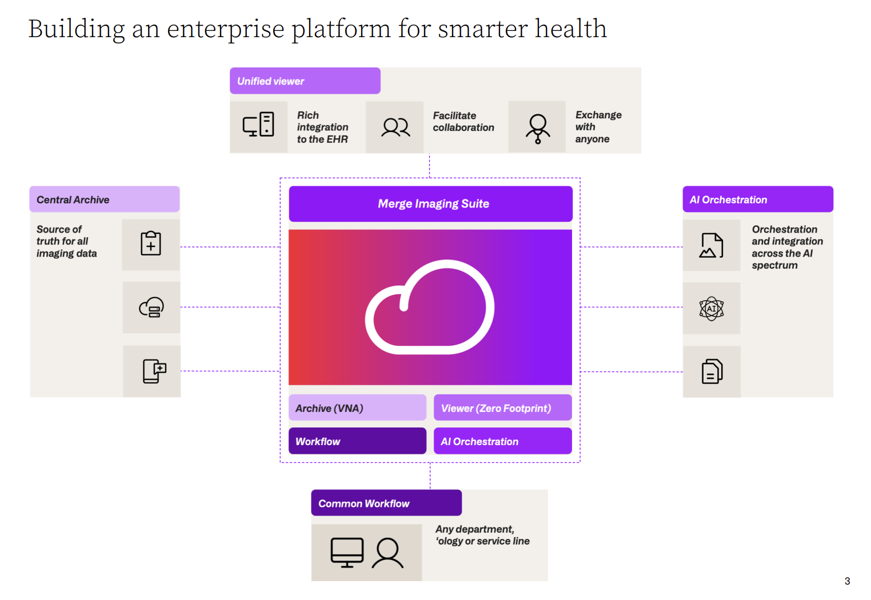

Slide 5
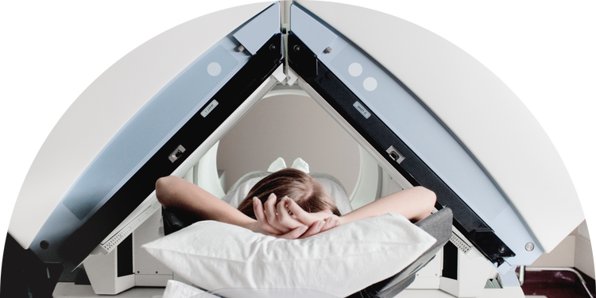
01
Key Features
Notes:
Ghjv

Slide 6
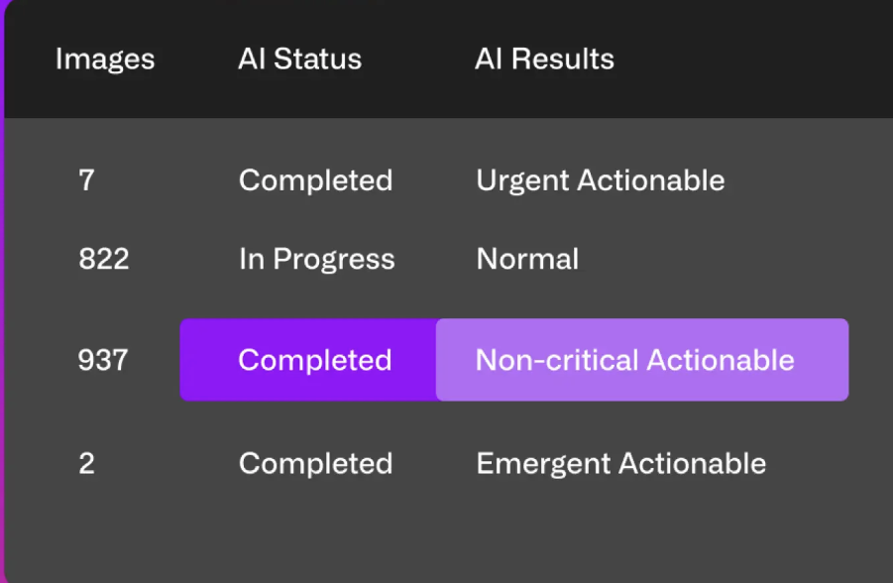
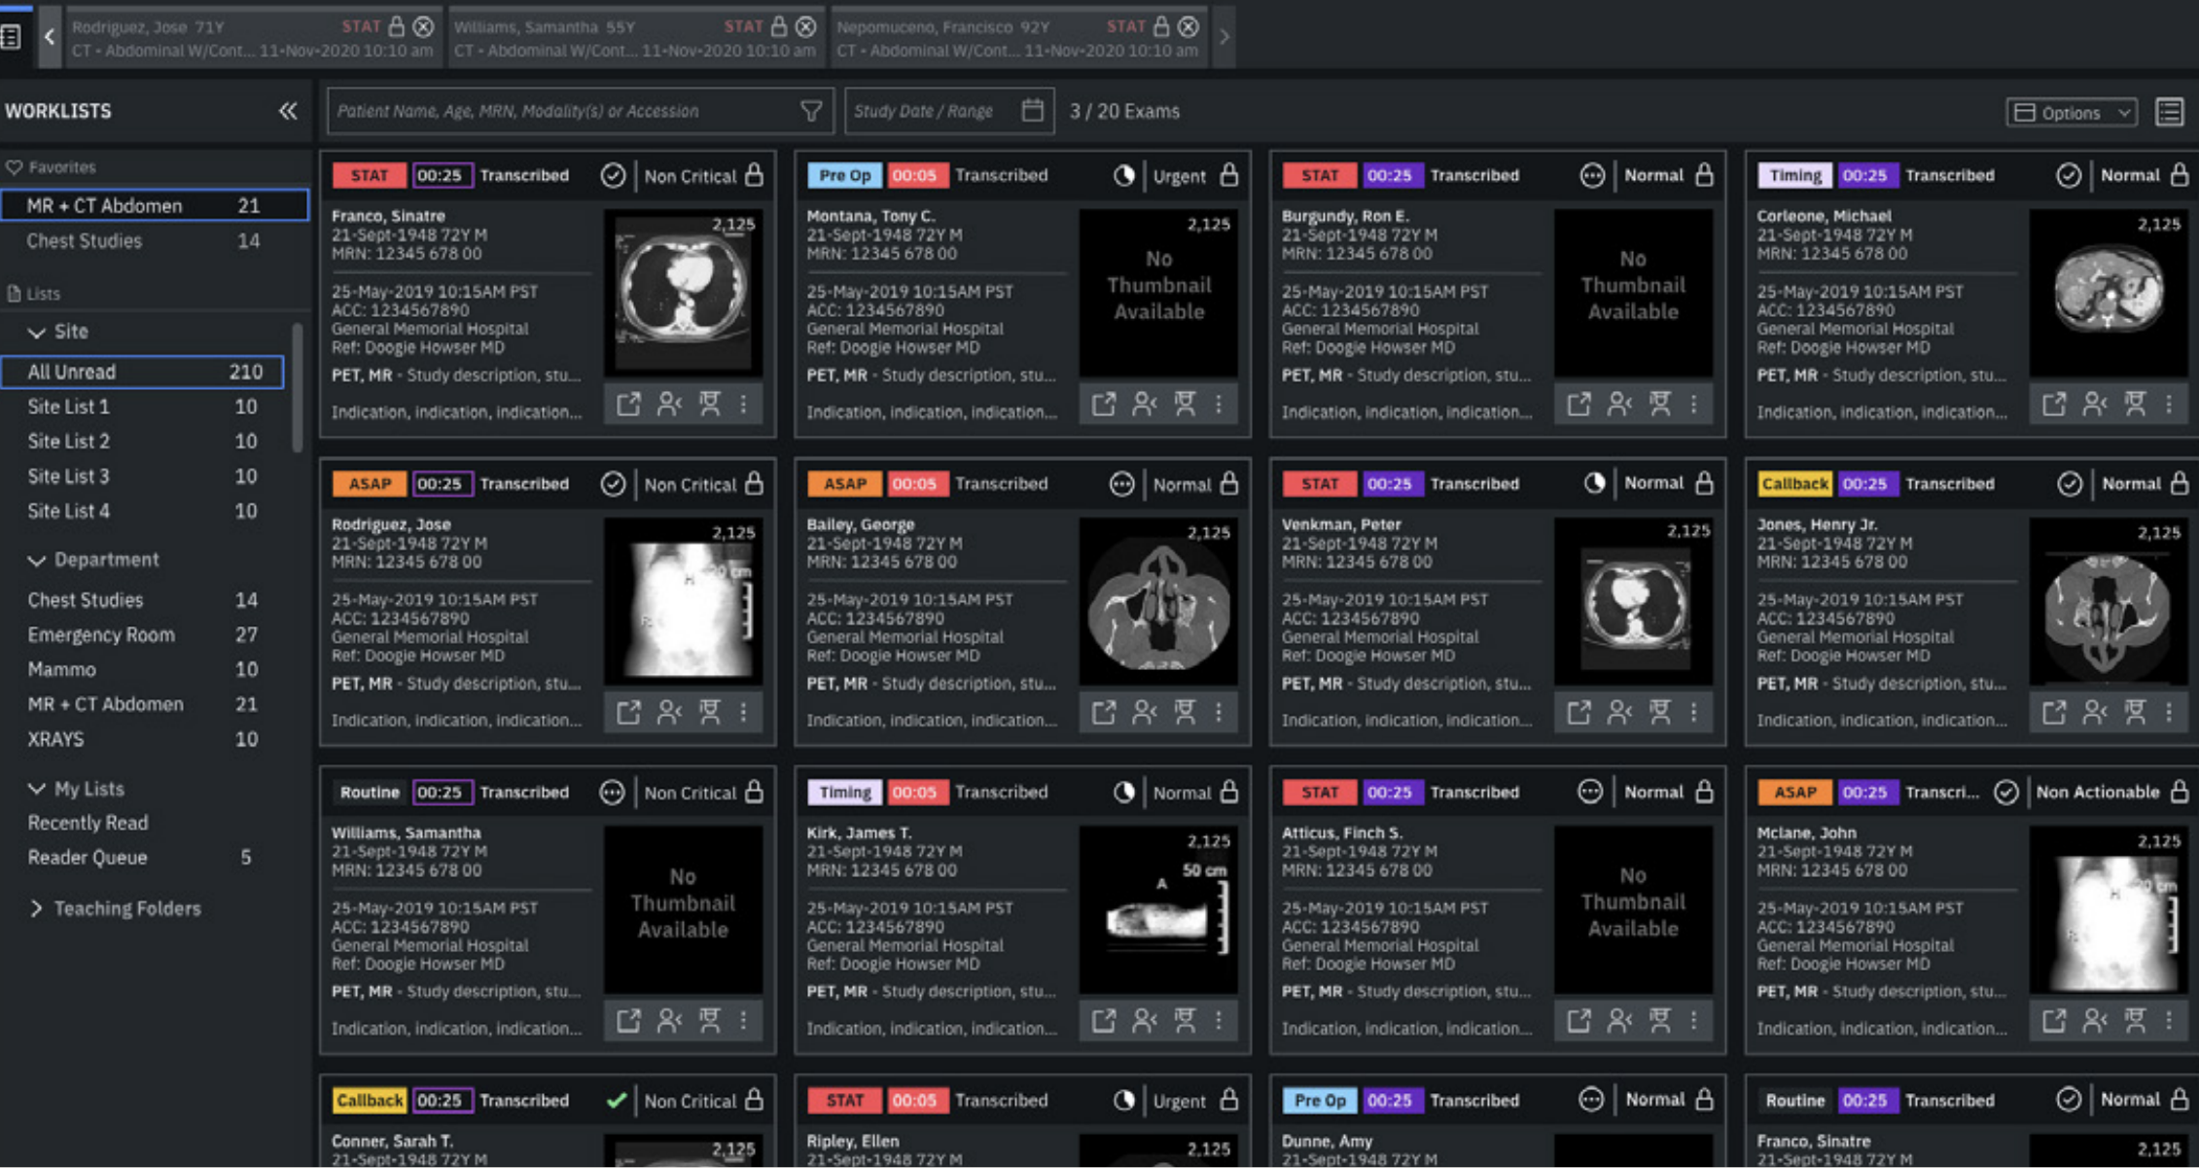
01
Infused with AI
Enhance the clinical team’s experience with AI insights—to streamline processes, improve workflows, enhance clinical outcomes, and increase provider satisfaction.
Enabled Hybrid Cloud
02
Merge takes things one step at a time: The applications can be connected from on-premise to cloud and from cloud to on-premise as preferred. A hybrid-cloud approach enables to adapt in a measured way that minimizes risk and leverages current investments.
Key Takeaways – Merge has integrated AI and cloud to enhance its services

Slide 7

02
Leveraging AI

Slide 8
Leveraging AI - AI Orchestration
Problem: For imaging organizations who are looking for a strategic approach to deploy AI at scale Solution: The Merge AI Orchestrator simplifies the deployment, management and orchestration of AI applications across imaging workflows, offering a cloud-based solution for standardizing the delivery of valuable AI insights to radiologists, handled by Merative
AI Orchestrator intelligently routes images to the correct AI algorithms and sends status back to the PACS worklist.
When they are ready for viewing, results are noted in the worklist, with urgent items highlighted so that the radiologist knows where immediate attention is needed.
Routing via a single gateway to the imaging environment, AI Orchestrator eliminates the need for IT teams to deploy and manage multiple AI applications
AI applications - 1. Breast imaging 2. Neurology 3. Thoracic 4. Musculoskeletal 5. Triage

Slide 9

03
Value Propositions

Slide 10
Drawing a comparison between a Key Features and Value Proposition
Key Features | Key Value Propositions
Early Adopter Programs | A sample prototype – which are designed to limit risk, optimize results, and generate the proof needed for the benefit of all.
A high-performance viewer (UI) | This improves reading workflows anywhere in the enterprise
Merge RIS (Merge Dashboards) | Accomplish revenue and productivity goals by building a customized workflow solution that optimizes daily operations – from orders and reports, to billing and analytics.
Merge Med Specs | Centralized data storage where the doctors can access images from multiple locations and diagnose anywhere
Workflow Orchestration | Unifies patients data + Images + AI Results in a single platform
Cloud Native SaaS | Safety linking data tools running on premise to cloud to reading experts anywhere
Zero Foot print viewer + Rich VNA | Low maintenance + cost effective infrastructure

Slide 11
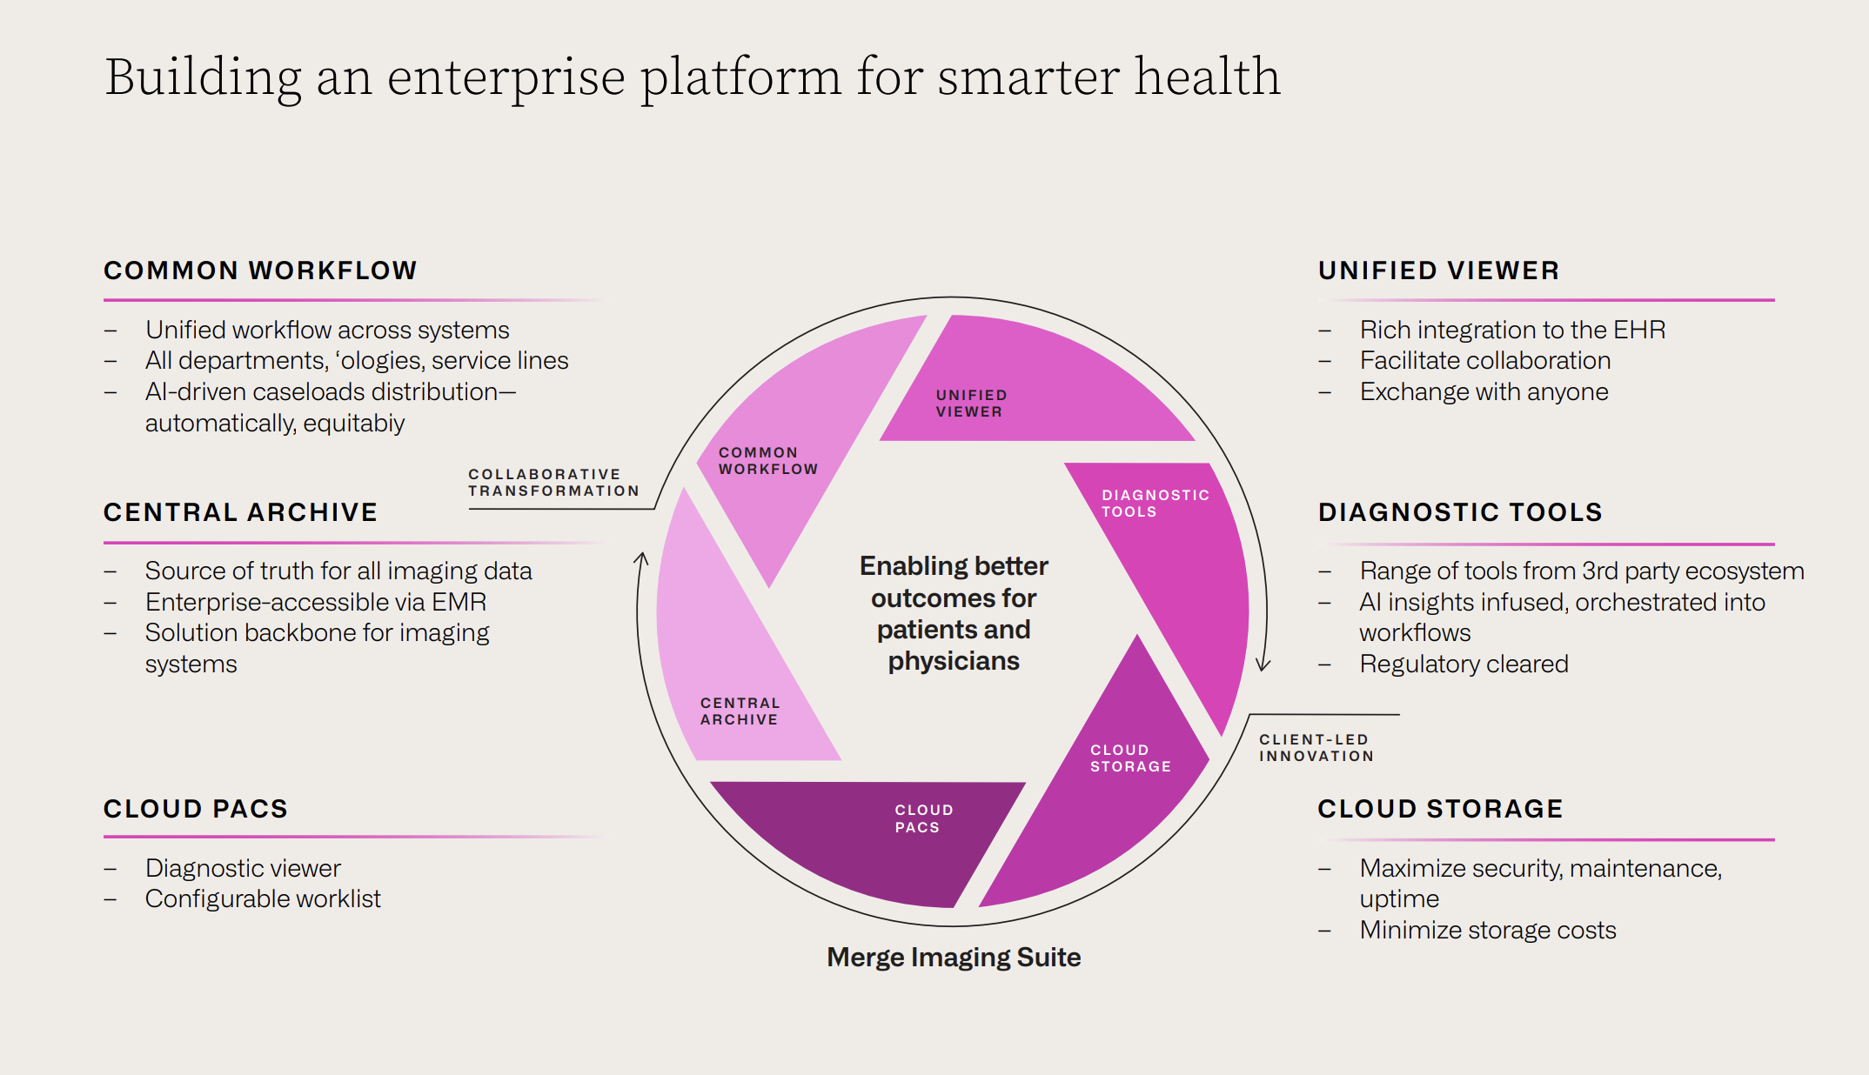

Slide 12

04
Marketing Strategies

Slide 13
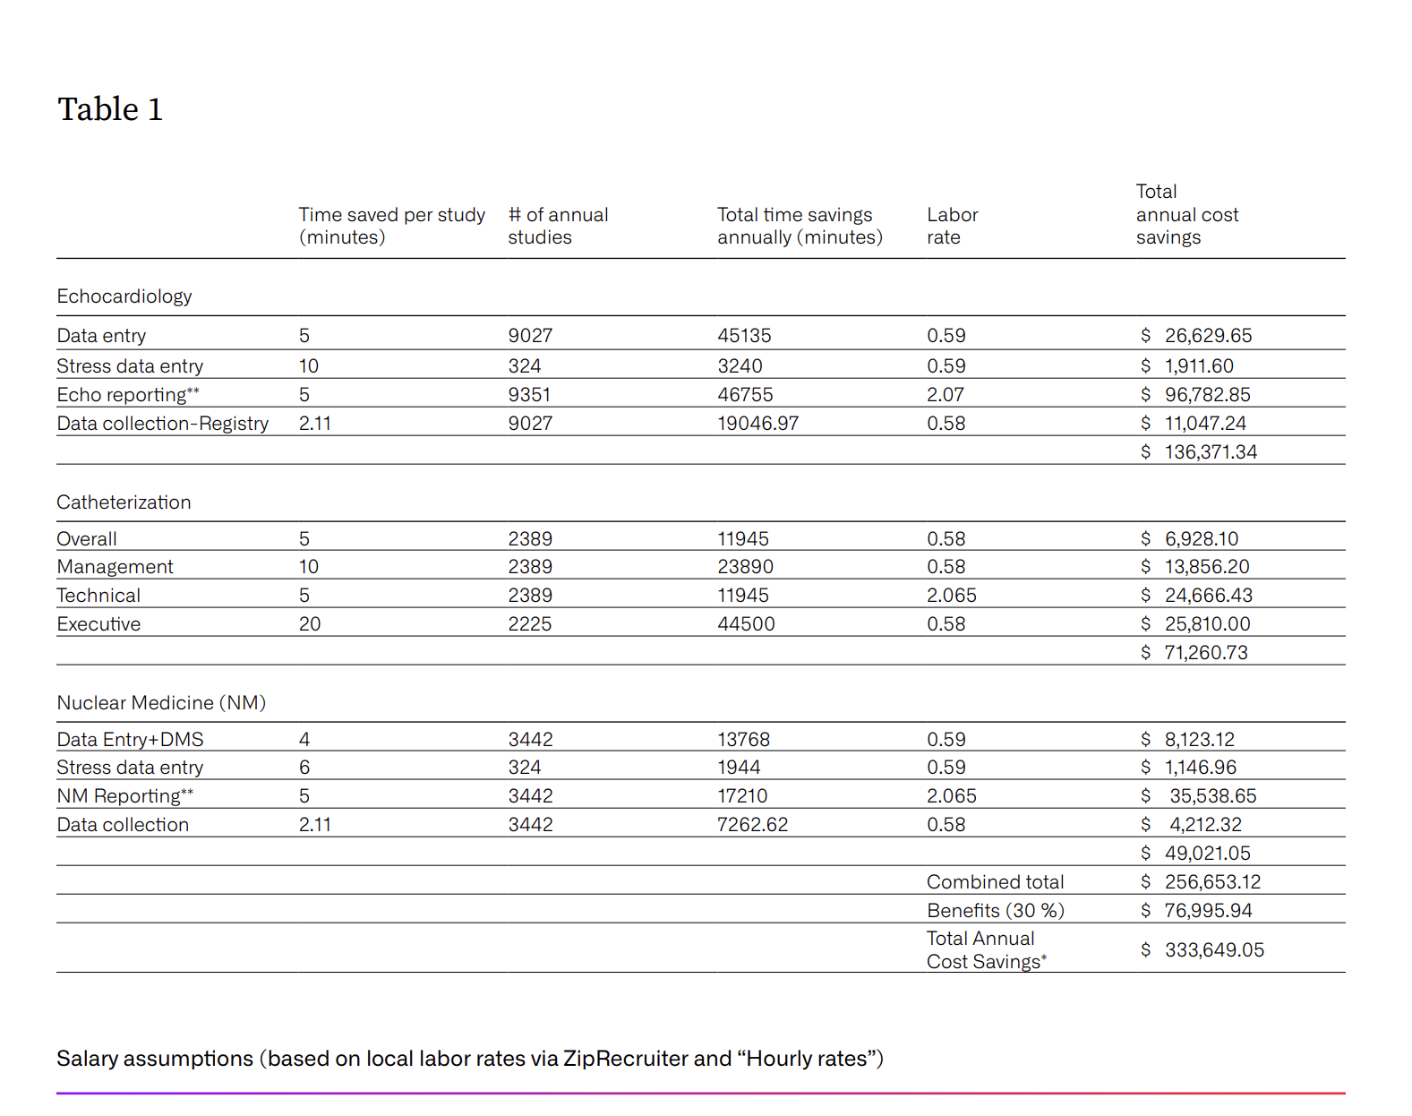
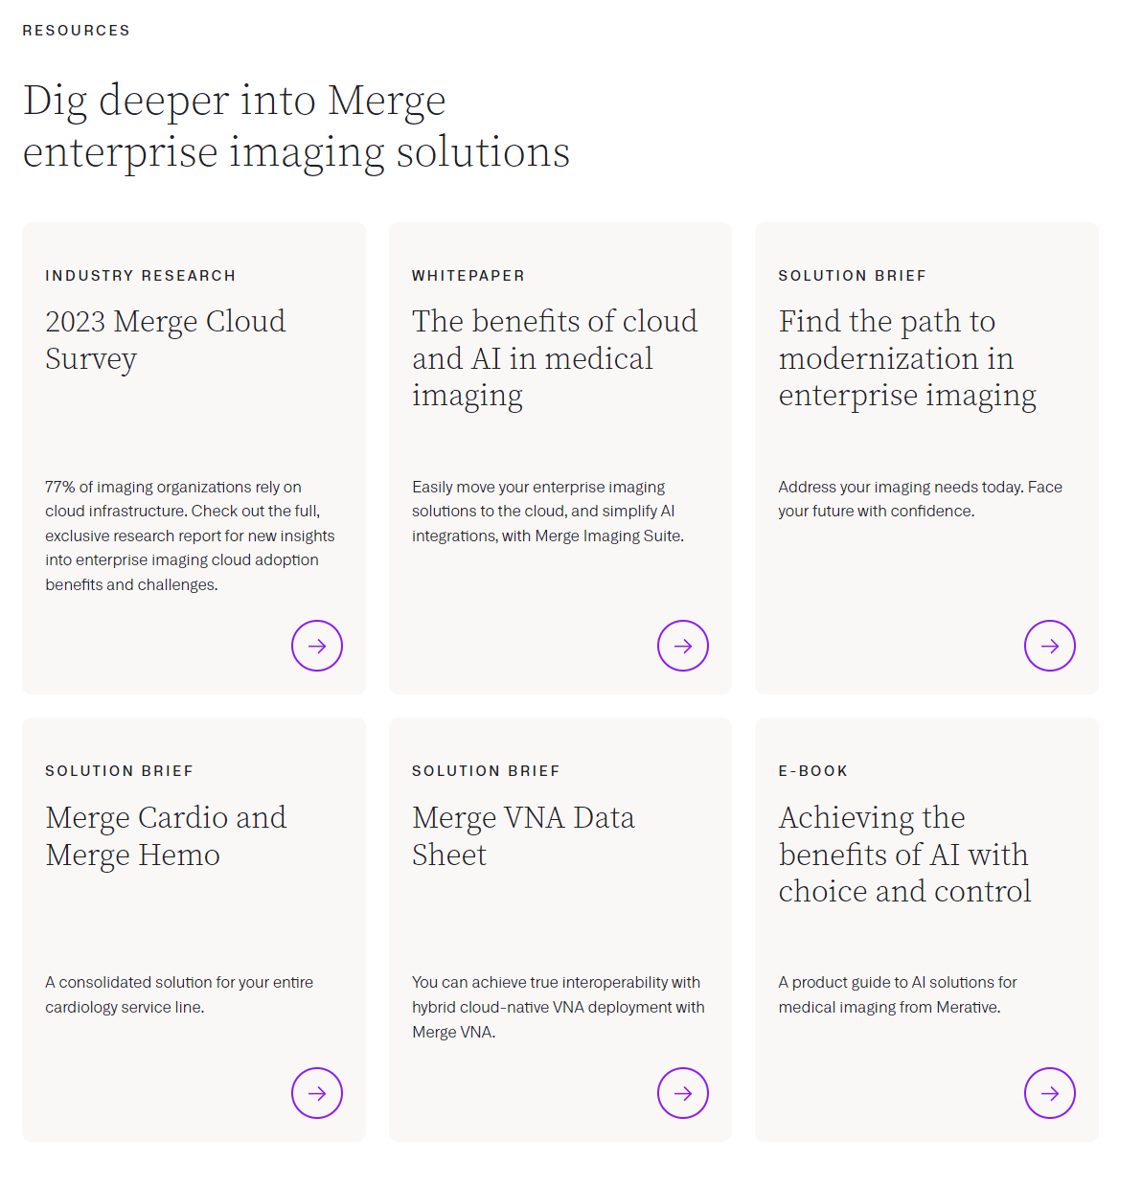
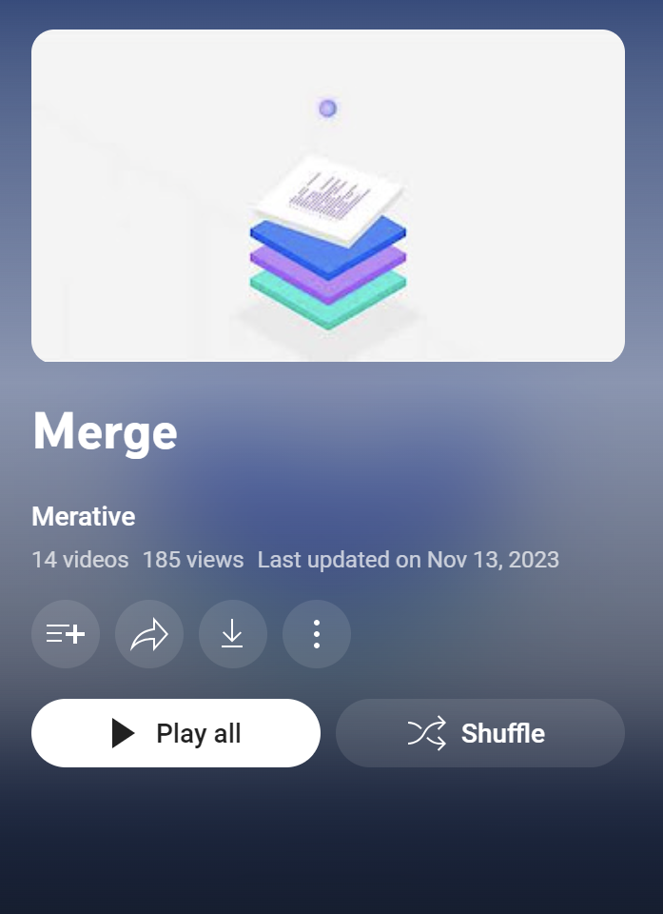
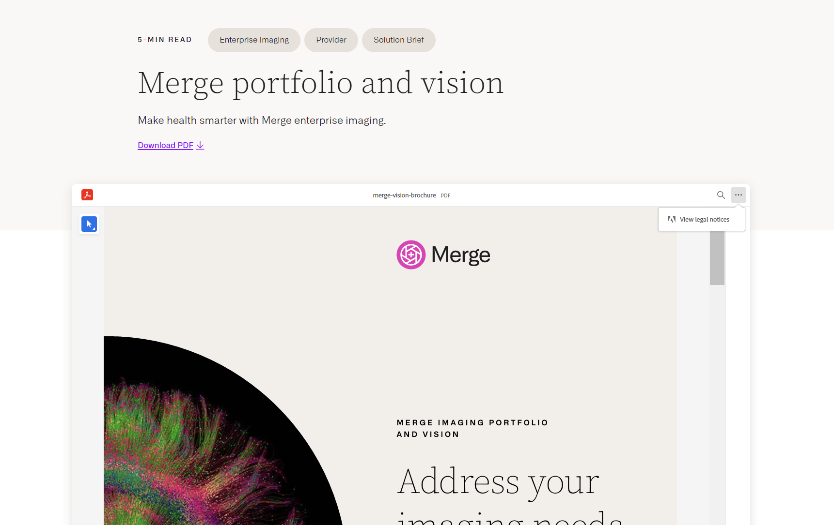
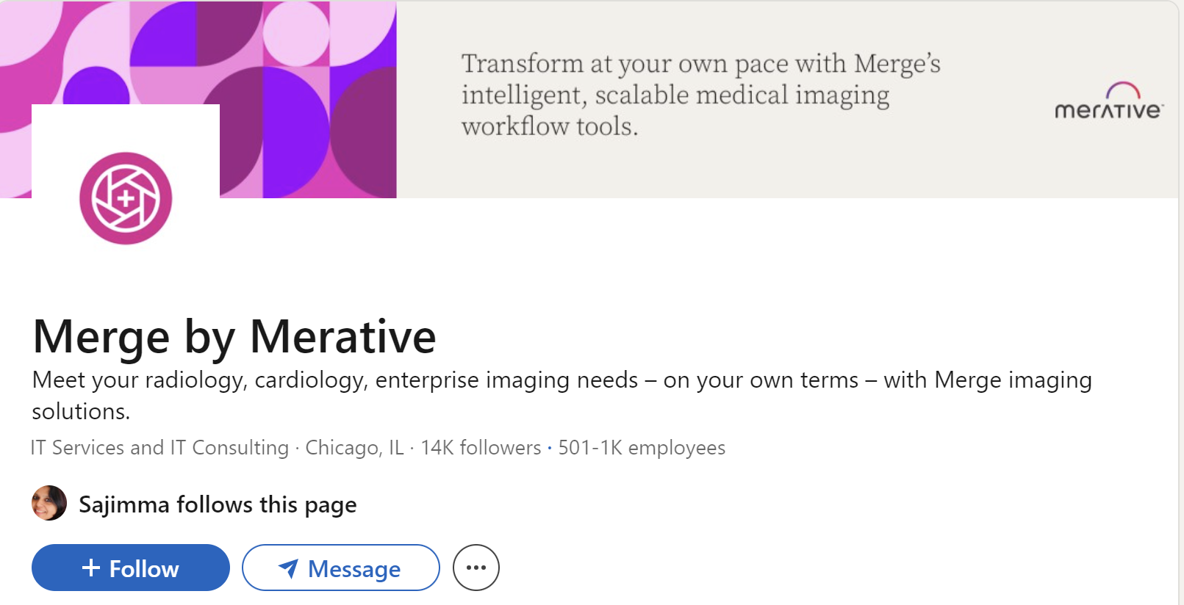
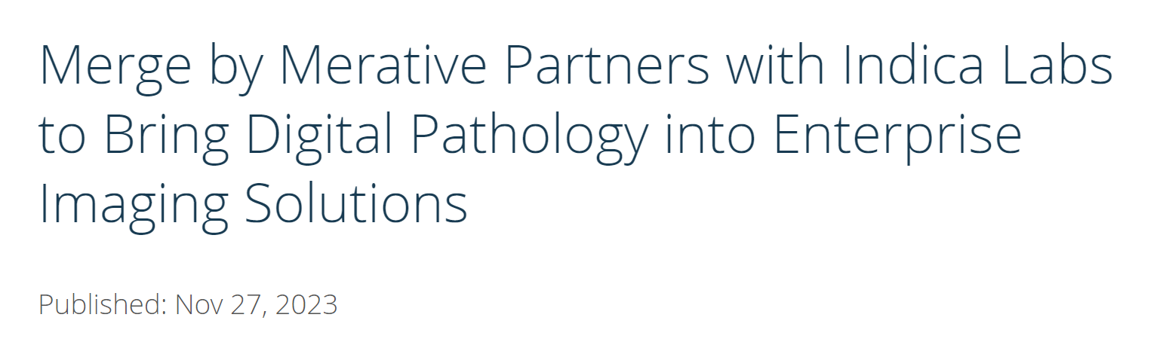
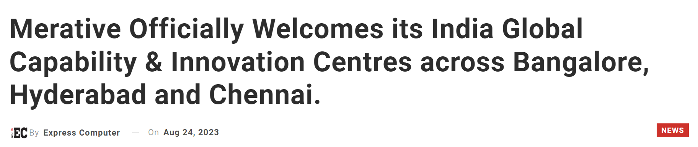
Marketing Statergies
Mass Media - News
Youtube Presence
LinkedIn Presence
Product Brochure's
Credible recourses over website
Merge by Merative uses 3 key strategies to elevate its marketing and communication:
Social Media – LinkedIn and YouTube
Mass Media – News platforms
Credible recourses over websites
Product Brochure's
Opinion – Other social media platforms such as Instagram and Facebook can be used to target wider audience and collaborate with small town hospitals

Slide 14
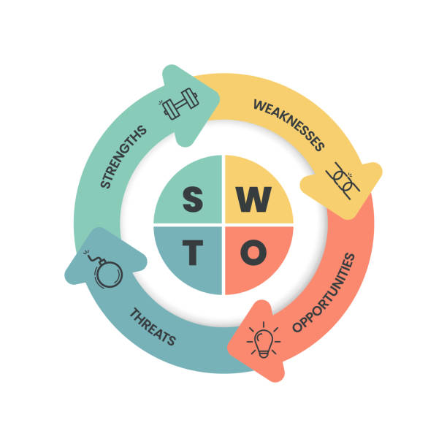
05
SWOT Analysis

Slide 15
SWOT Analysis
Widespread recognition within the Enterprise Imaging space, bolstered by over 30 years (1987) of establishment under the esteemed Merge brand, which boasts a substantial install base.
Merge by Merative has the potential to capitalize on the increasing demand for cloud-based solutions in healthcare by leveraging its diverse product portfolio and fostering strategic partnerships and collaborations with cloud service providers and other healthcare technology companies
Strengths
Weaknesses
Limited ML Focus : The shift in focus from creating algorithms to enhancing workflow efficiencies may limit competitiveness in the ML space compared to competitors focusing on ML algorithm development.
Opportunities
Threats
Rapid technological advancements and changes in industry standards may pose risks to Merge by Merative's product development and market positioning if it fails to keep up with emerging trends.
Harmful
Helpful
Key takeaway - Merge can seize the healthcare industry's demand for cloud solutions through its established reputation, diverse product range, and strategic partnerships, but must stay adaptable to tech advancements to stay competitive.

Slide 16

06
Competitive Intelligence framework

Slide 17
Business Model Canvas – Merge by Merative
Key partners | Key activities | Value propositions | Customer relationship | Customer segments
 | Key resources |  | Channels
Making workflows easier
Automating functions within the org
Doctors and Physicians
Hospitals
Hospitals
Health care providers
Data presence for the last 30 years
Making reports accessible from anywhere
Social Media
Mass Media
Cost structure | Revenue streams
Staffing
Minimal Cloud Maintenance
Hospitals and Health Care Organisations

Slide 18

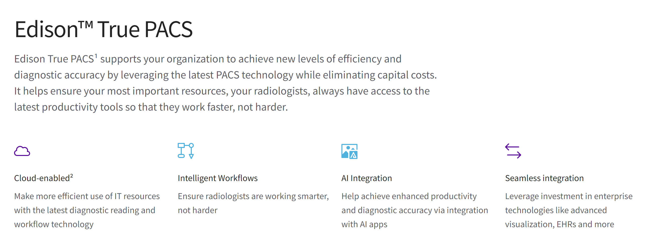
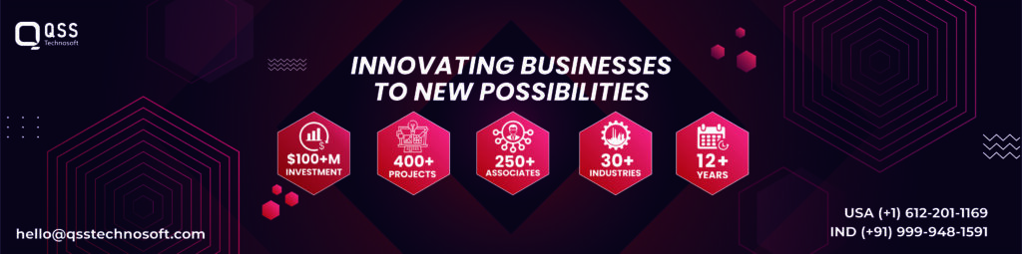
Competitors in the market
Ram soft (1994)
QSS Technosoft (2010)
GE Healthcare (1994)
Top 3 Competitors in the market along with Merge by Merative are,
GE Healthcare (1994)
Ram soft (1994)
QSS Technosoft (2010)
Key takeaway – Compared to the other mentioned solutions, Merge by Merative boasts a 30-year history, substantial data holdings, and a background including the affiliation with IBM Watson Health.

Slide 19
Resources https://www.merative.com/ https://www.merative.com/content/dam/merative/documents/ebook/achieving-the-benefits-of-ai.pdf https://www.merative.com/documents/brief/imaging-vision-brochure https://www.merative.com/documents/brief/merge-path-to-modernization-in-enterprise-imaging https://www.merative.com/content/dam/merative/documents/brief/merge-vision-brochure.pdf https://www.merative.com/content/dam/merative/documents/analyst-report/cloud-survey-report-2023.pdf https://www.merative.com/content/dam/merative/documents/brief/merge-path-to-modernization.pdf https://www.linkedin.com/pulse/top-10-dicom-pacs-software-development-companies-usa-qss-technosoft-gelmc/ https://www.merative.com/documents/case-study/soin-case-study https://www.merative.com/documents/case-study/4-ways-case-study

